Slide 1

CTM Cash Management Transformation Project
2026

Slide 2










Banking Operational Overview and 2025 Metrics
32
23
170
18
48
91%
LEGAL ENTITIES WITH ACCOUNTS
COUNTRIES
ACTIVE ACCOUNTS
CURRENCIES
BANKING RELATIONSHIPS
BALANCE VISIBILITY
1266
Access Points
93
61
58
181
100
13
ACCOUNT SIGNERS
SIGNER UPDATES
BANK PORTALS
PORTAL USERS
PORTAL USER UPDATES
KYC UPDATES

Slide 3







Key Objectives
Liquidity Optimization
Cost Efficiency
Ensure purposeful real-time visibility of cash across all entities and regions.
Minimize idle balances and maximize returns through pooling or sweeping structures.
Reduce banking fees, transaction costs, and FX conversion expenses.
Rationalize bank accounts and relationships globally.
Standardization & Automation
Risk Management
Working Capital Efficiency
Harmonize payment processes, approval workflows, and reporting globally.
Deploy ION IT2 TMS and API/Host to Host integrations for automation.
Mitigate FX volatility, interest rate risk, and counterparty risk.
Implement robust fraud prevention and cybersecurity measures.
Optimize receivables, payables processes to free up cash.
Align cash forecasting with operational cycles.
Strategic Flexibility
Regulatory Compliance
Enable quick access to liquidity for acquisitions, expansions, or crisis response.
Support global growth with scalable cash management infrastructure.
Adhere to local and international regulations (tax, FX, AML/KYC).
Maintain audit-ready processes and documentation.

Slide 4















CTM Future State Systems Overview
Citibank conversion
ION IT2 (Payments, Sanctions screening, Vendor verification)
BOA IREC (AR automation)
REGION / DIVISION
VIEW
CORPORATE VIEW
Physical Accounts
Manual Payment Requests/Approvals
(and Business Continuity)
LFMM
ZENITH
NMC
AGRICARE
FMOG
GMA
PATIVOIRE
GMD
MOCHASA
BEIRA
IAG/UAG
NMG
GMPN
API Call - Repetitive
Code Information for Wires
Check Transmission
Entity Report Access
Monthly Check Recon File
IT2 Anywhere
Current Day Cash Positioning
Prior Day / Current Day API Balance / Transactions / Payment Status / Disbursement Funding Report
Wire Payment Journal
Prior Day Reconciliation
ACK / NACKS
Wire Transmission
IT2
Payments STP
ACH File Transmission
Accounting entries
Sanctions File
Vendor Verification File
Positive payee / Monthly Check Recon File /
Paid and Outstanding Files
Virtual Credit Card File
ACH File
Wire File
Sanctions Screening Service
Check Printing File
Bank of America Intelligent Receivables®
Payroll File
Vendor Verification
SFTP: AR Information to bank
AR information from bank
Statement with incoming transactions

Slide 5
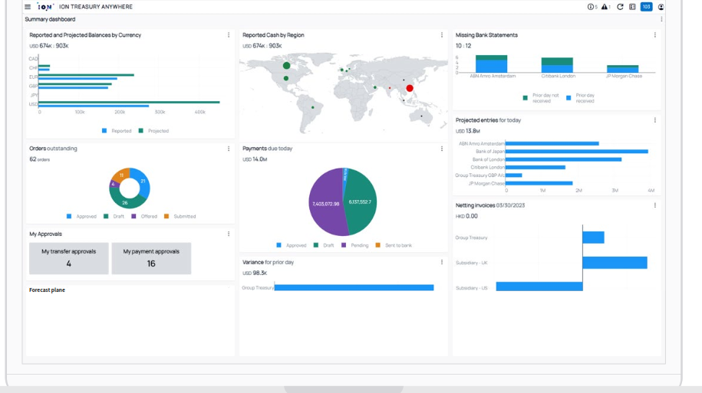
TMS – IT2 & IT2 Anywhere

Slide 6
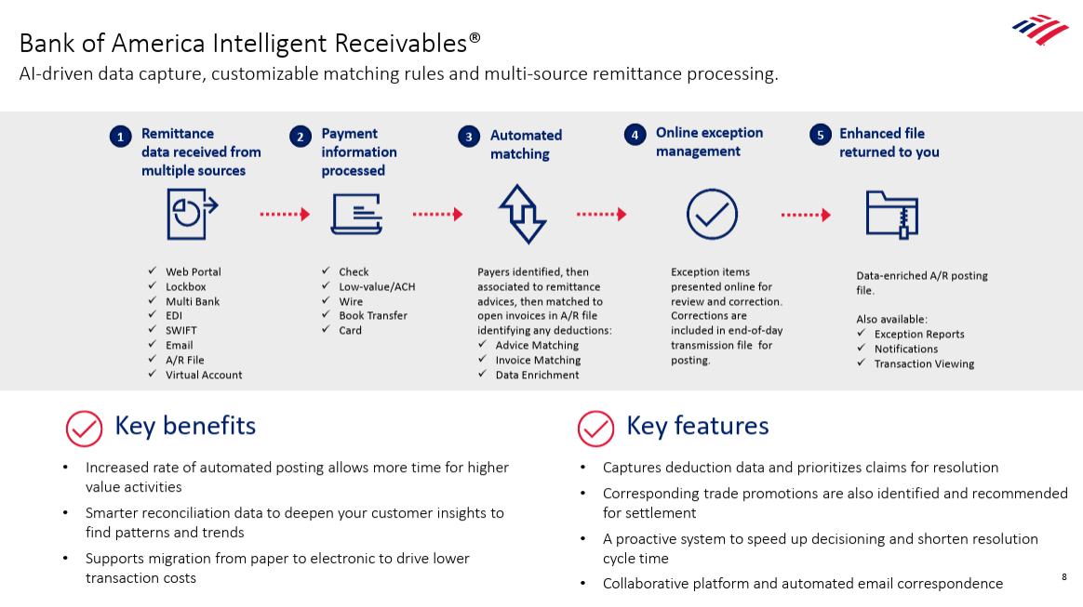

Accounts Receivable Application Automation

Slide 7
Implementation Roadmap
1
2
3
LIVE
ASSESS
IMPLEMENT
SCALE
Phase 1: Rapid Assessment
Phase 2: Implementation
Phase 3: Scale & Optimize
Banking Footprint & Rationalization
Blocker identification
Current and Target Process Design
Current and Proposed Technology Assessment
Account rationalization
Payment & collections digitalization
Just-in-time funding
Just-in-time repatriation
AR automation & real-time visibility
Wave 2 rollout
Receivables & operational dashboards
Policy & controls
Training & handoff
Output: Approved design
Output: Ivory Coast operational
Output: Senegal operational

